Slide 1



Git & Github
Manoel Fernando Alonso Gadi Associate Professor
mfalonso@faculty.ie.edu
WORKSHOP

Slide 2

Git local tools
Command Line:
https://git-scm.com/downloads
Desktop:
https://desktop.github.com/

Slide 3


Git-Github

Slide 4
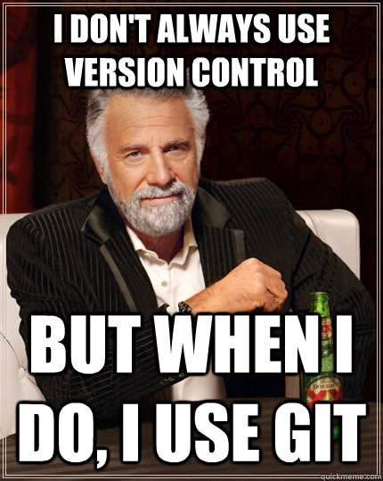

Slide 5



It is Kahoot time
https://create.kahoot.it/k/de999bdd-a9d1-4571-a9e5-d1fc1c7f060a

Slide 6
Git
Mainly the version control protocol, but if someone mentions he/she normally means the git command line software.
Git Desktop
Software implementing git protocol and using github as remote repository
Github
repository site

Slide 7


Slide 8
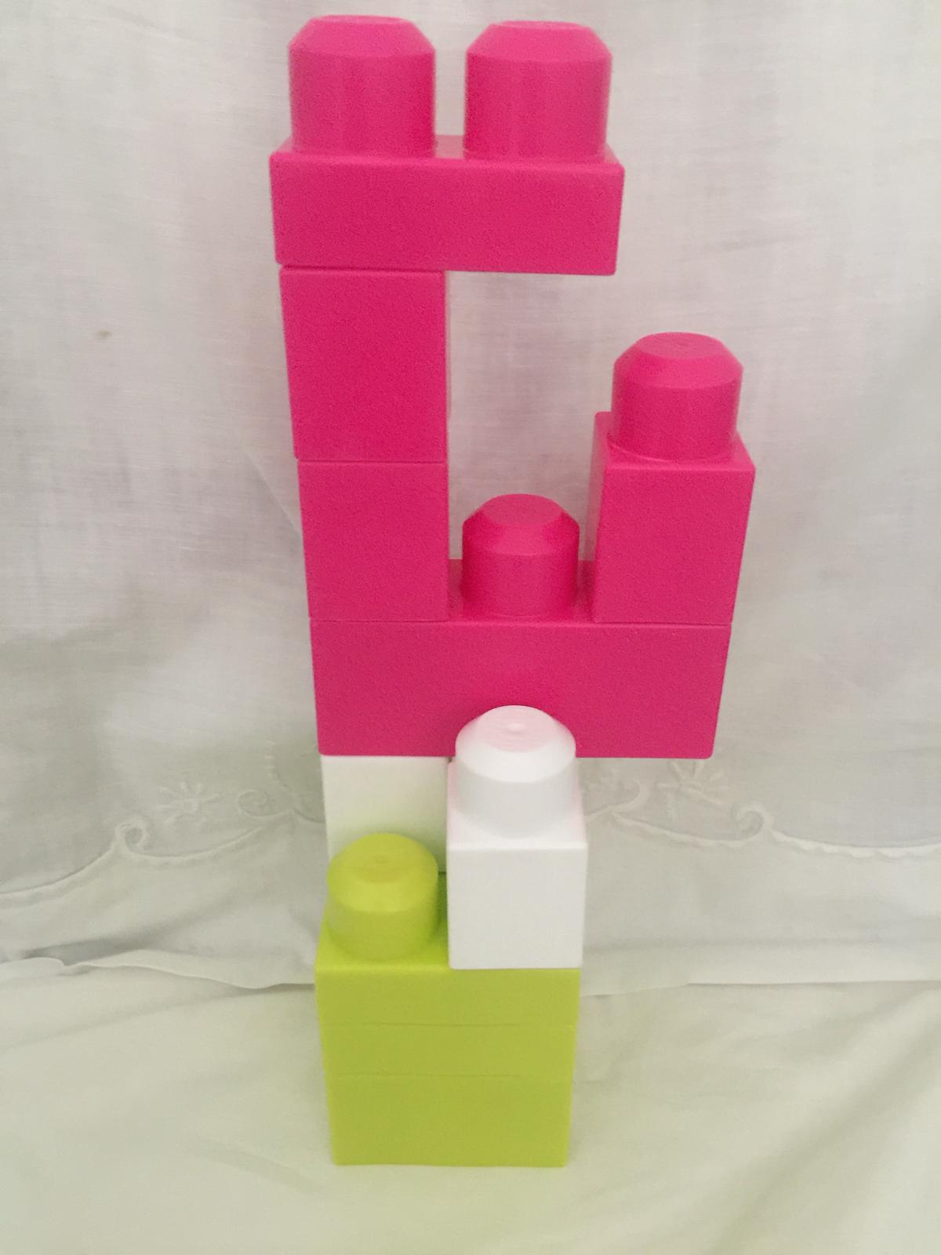
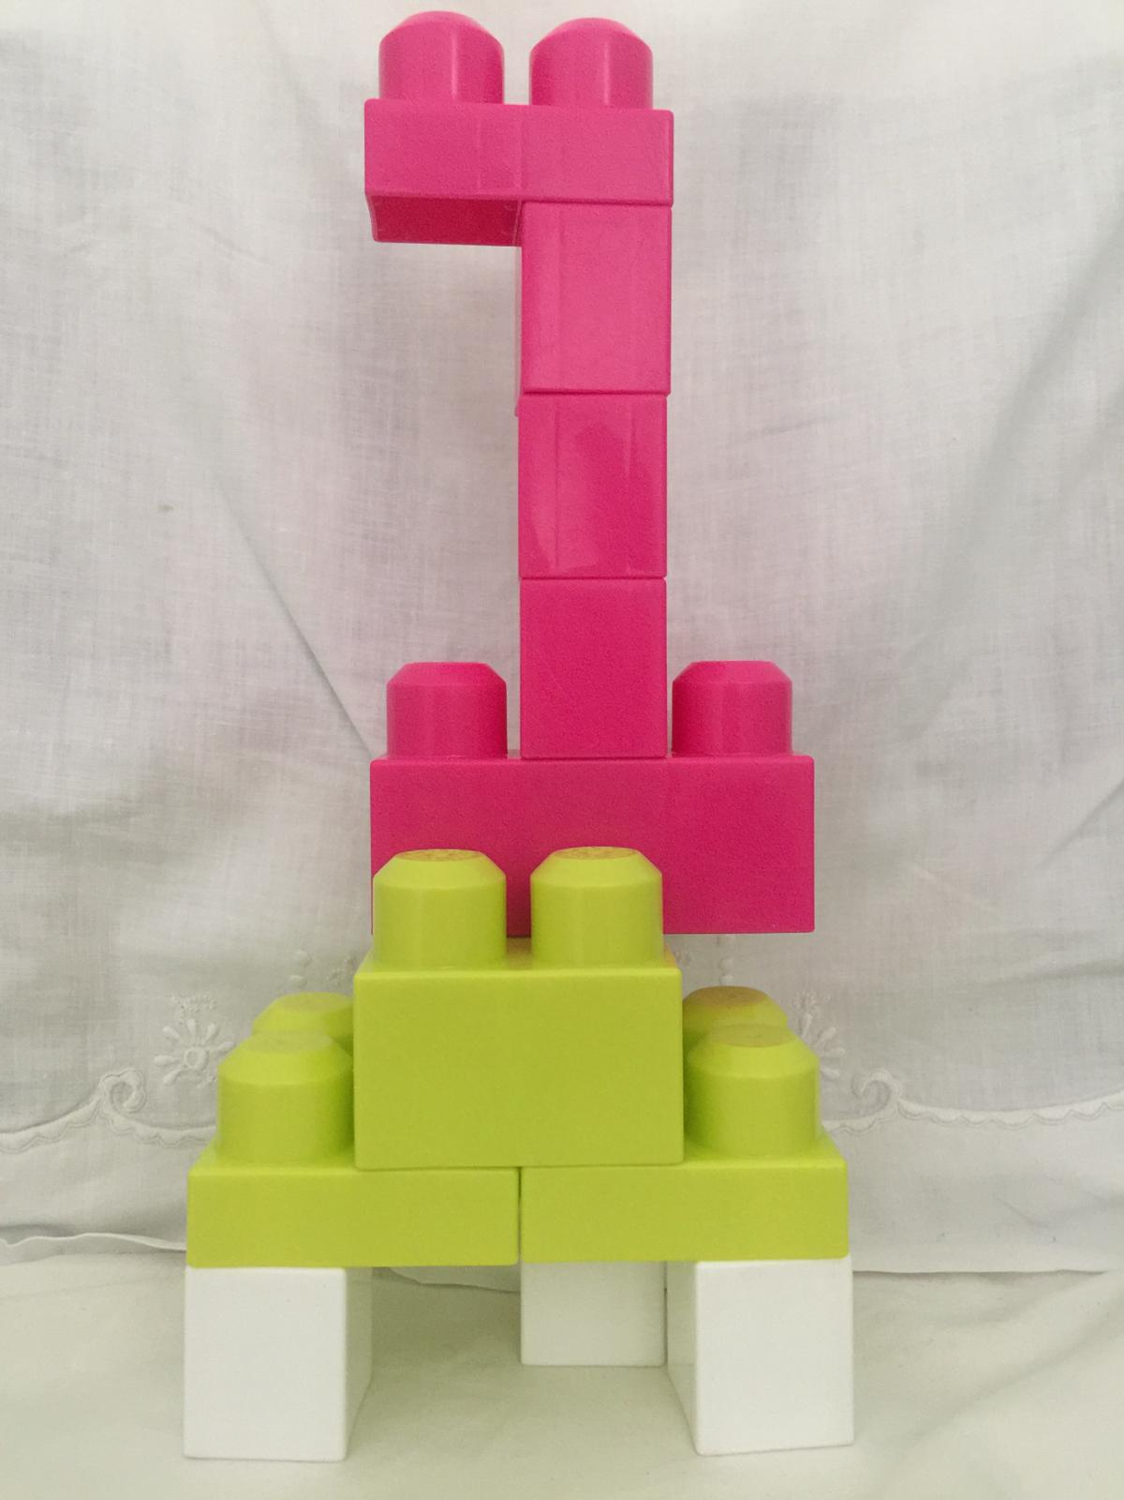
Starting Point
Objective

Slide 9






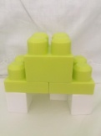

Starting Point
Final Point
Remote Repository
git commit -m "first commit"
clone
git add part1.lego
git add part2.lego
git push origin master
Local Repository
Do some
work

Slide 10


Python Collaboration Exercise
Write a script named main.py and inside it import all students functions, make a simple call of the functions 1,2 and 3 with N = 5, function 4 with C = 1, D = 2 and H = 3, and function 5 and 6 with the list [1,2,3,4,5]. Finally, print all the result.
Write a script named student1.py and inside a function called mydivisible7not5 that takes a parameter N and returns 1 if N is divisible by 7 but it is not a multiple of 5 or 0 otherwise.
Write a script named student2.py and inside a function called myfactorial that takes a parameter N and returns the calculation of factorial of N (N!)
Write a script named student3.py and inside a function called myfibonacci that takes a parameter N and returns the calculation of Fibonacci of N
Write a script named student4.py and inside a function called myformula that take parameters C, D and H and returns the Square root of [(2 * C * D)/H]
Write a script named student5.py and inside a function called mylistofquares that receives a list of numbers and returns a list with the square of every number in the input list
Write a script named student6.py and inside a function called mydictofquares that receives a list of numbers and returns a dictionary with the input number as key and its square as value

Slide 11
Git command line – important commands:
• git clone https://github.com/... (Replace https://github.com/... with your own github project url)
• git init (login)
• git pull (pull changes)
(To some work! Change files or create new files)
• git add . (add all changes to next commit)
• git commit -m "first commit“ (prepare files to upload)
• git remote rm origin (removing pointer to remote repository)
• git remote add origin https://github.com/...
(Making sure git knows where to push changes to! Replace https://github.com/... with your own github project url)
• git push origin master (actually sending the files)

Slide 12
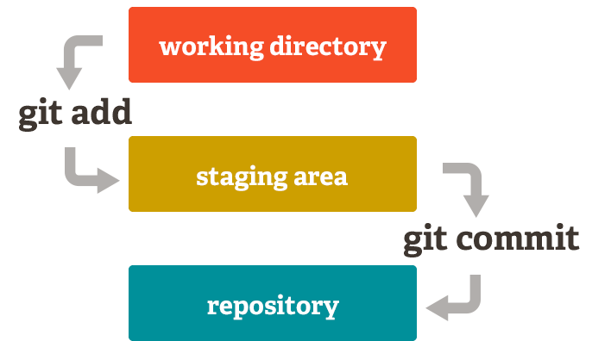

Slide 13
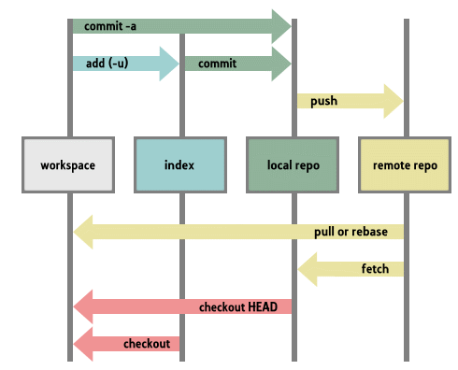

Slide 14
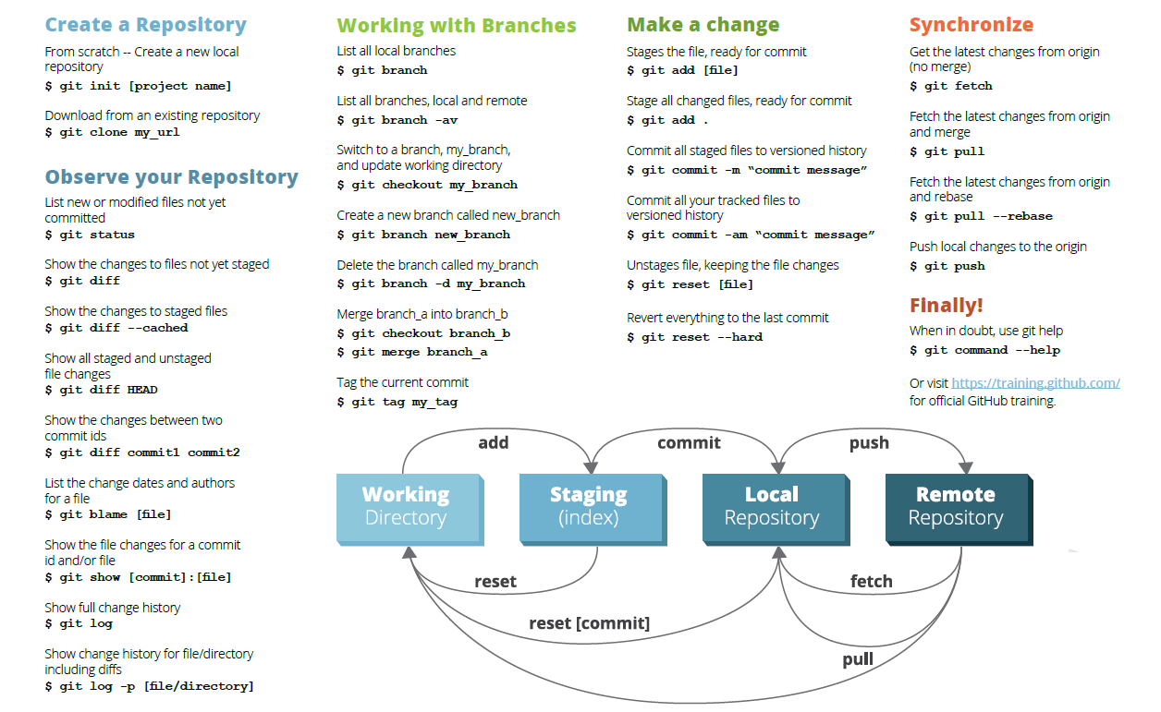
http://files.zeroturnaround.com/pdf/zt_git_cheat_sheet.pdf

Slide 15


Slide 16
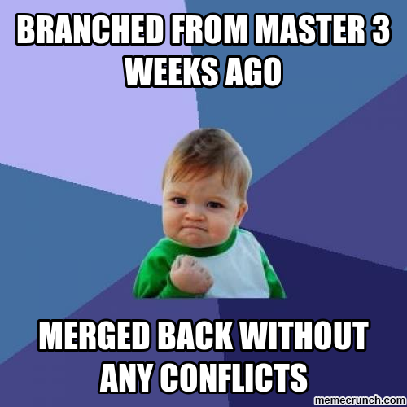

Slide 17
Git & Github
Manoel Fernando Alonso Gadi Associate Professor
mfalonso@faculty.ie.edu
WORKSHOP

